Slide 1
OCE Hackathon – 2024
https://opencomponents.io/

Slide 2

OCE Hackathon – 2024
Speech is a primary part of the human/computer interaction requried for drafting/checking stages of Oral Bible Translation (OBT). And some Bible translation efforts target "low resource languages". As such, Bible translation software must understand spoken audio from low resource languages.
Thesis: Find a stable method for recognizing individual words in low-resource languages.
Here, we propose a model to recognize individual spoken words in Dholuo.
Definitions:
Here, "low resource languages" is understood as any language that does not have open, available models for LLM, speech-to-text, and text-to-speech.
By requiring a "stable" model, we require the solution to be independent of tone, volume, speed, or the speaker's gender.

Slide 3
OCE Hackathon – 2024
Thesis: Find a stable method for recognizing individual words in low-resource languages.
Definitions:
Low-resource language: A language that does not have open, available models for LLM, speech-to-text, and text-to-speech.
Stable model: the solution to be independent of tone, volume, speed, or the speaker's gender.

Slide 4
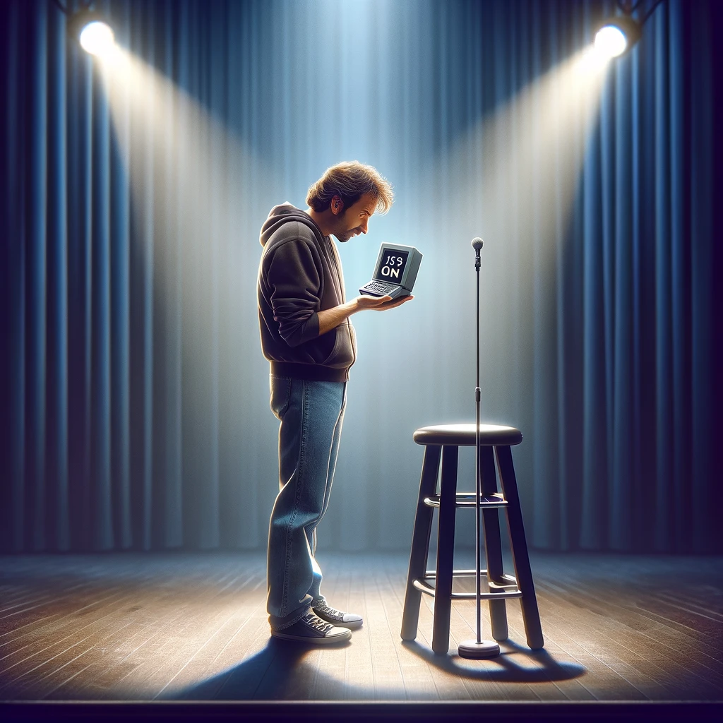
OCE Hackathon – 2024
Keyword checking prototype
AKA – “Is this thing on?”

Slide 5
OCE Hackathon – 2024
Method:
Python packages:
- librosa Encoding audio data
Collect the Data
Clean the Data
Explore/Visualize the Data

Slide 6
Collect the Data
Training data: Male voice & Female voice

Slide 7
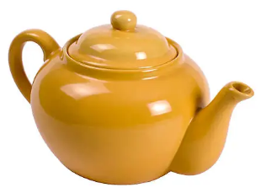

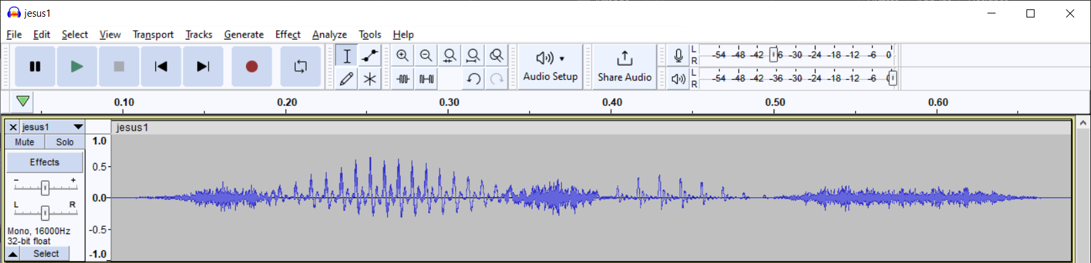
Clean the Data → & Feature Extraction
< 5.3, 3.2, 4, … >

Slide 8
Clean the Data
A standard process for cleaning speech data:
- Subtract noise floor:
Background
- Normalize:
Subtract out the mean
- Pre-emphasis:
“Lowering the ceiling” ~ “reducing contrast”
- Mel-Scale:
Related to human ear sensitivity

Slide 9
Feature Extraction
MFCC – Coefficients
Think ~ like PCA components
Or ~ like Fourier series coefficients
Mel-Scale:
Related to human ear sensitivity

Slide 10
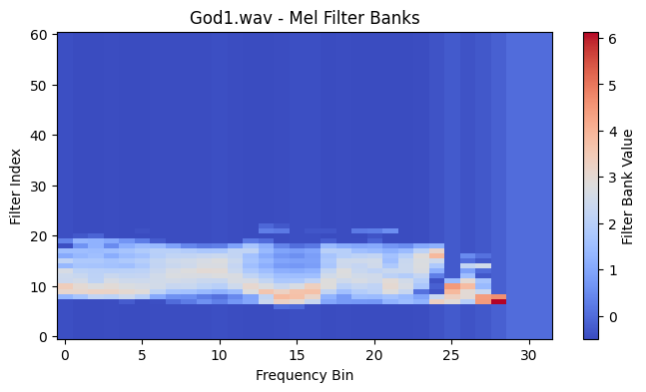
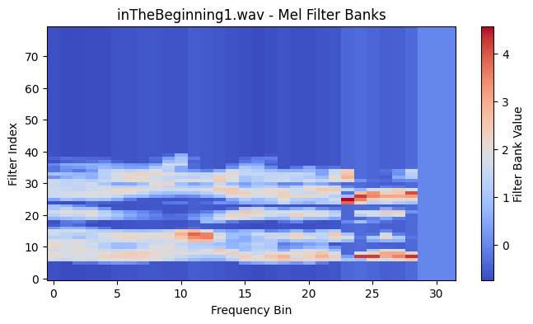
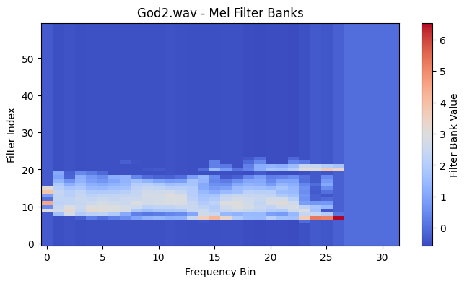
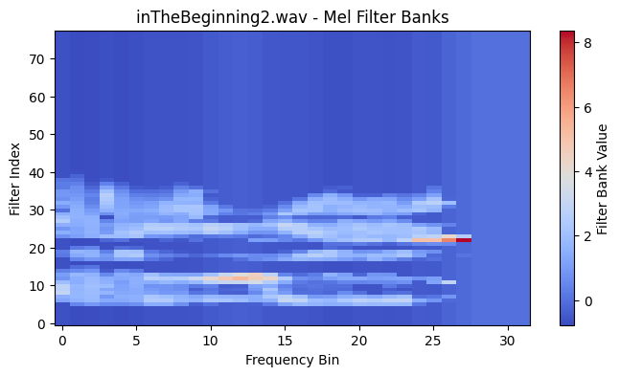
Explore/Visualize the Data

Slide 11
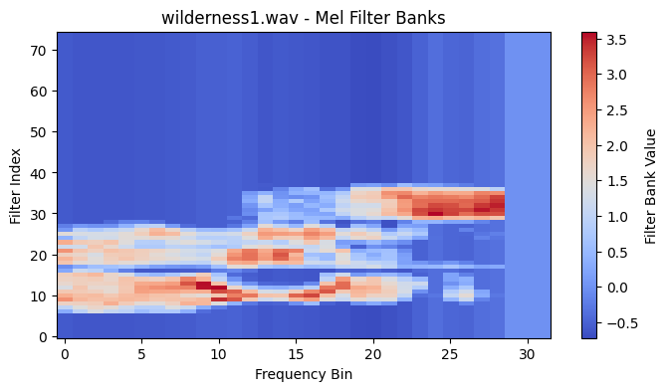
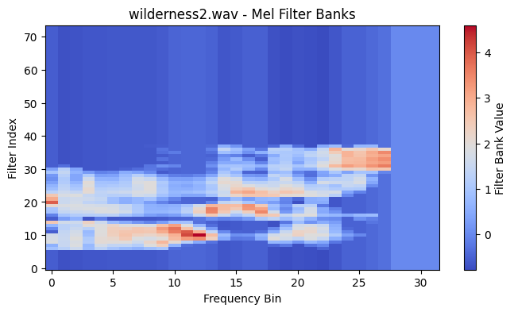
Explore/Visualize the Data

Slide 12
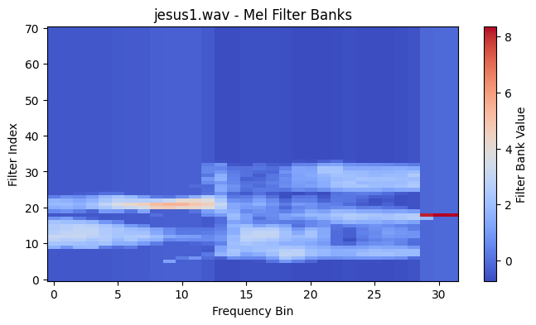
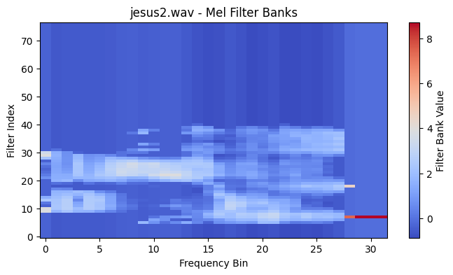
Explore/Visualize the Data

Slide 13
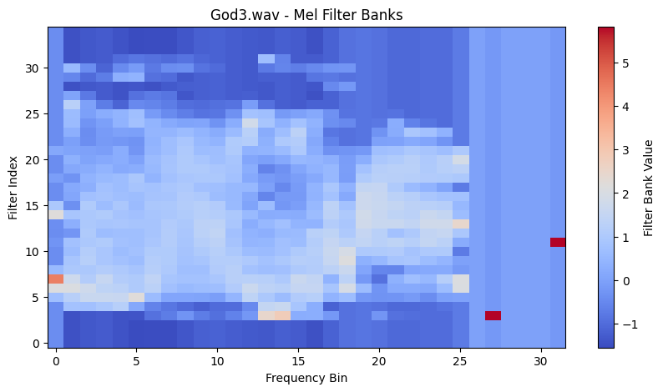
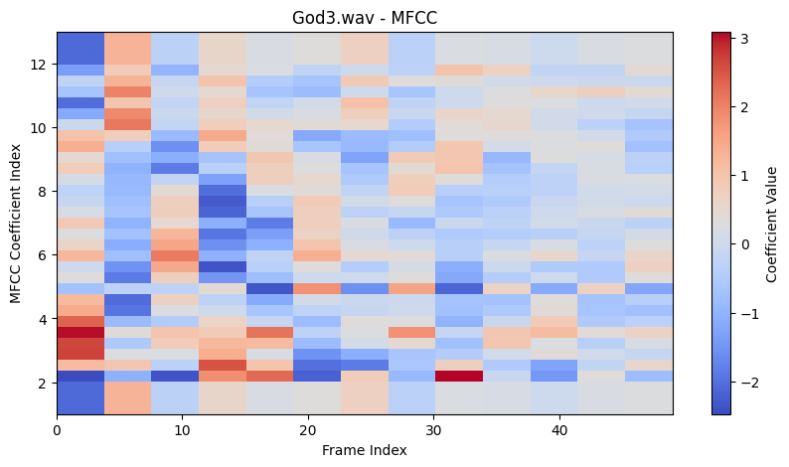

Slide 14
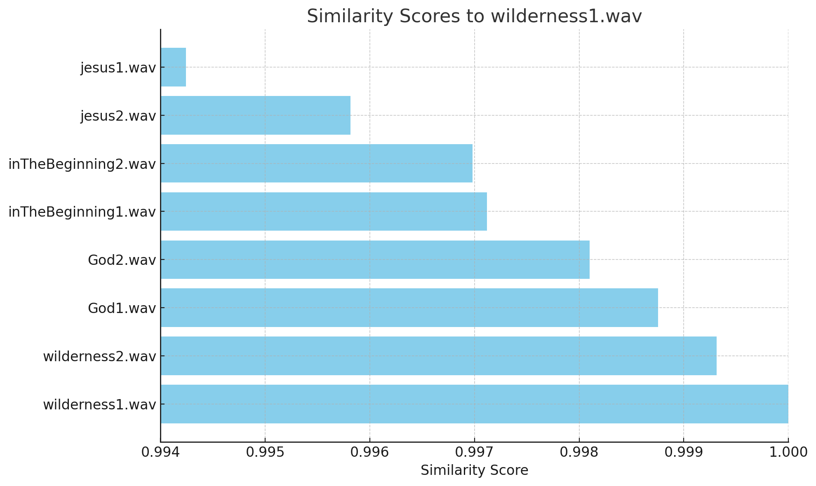
Off-the-Shelf Solution
We can start with an off-the-shelf solution (librosa mfcc feature extraction):
✔ This solution correctly identifies the correct forms,
❌ but it does not detect as much difference between the incorrect forms.
For keyword checking, it might be helpful to have a meaningful measure of how different the words are:
❌ No clustering!
Similar to wilderness1.wav:
wilderness1.wav: 0.9999999869496023
wilderness2.wav: 0.9993146675340262
God1.wav: 0.9987559253705995
God2.wav: 0.9980986833151937
inTheBeginning1.wav: 0.9971207291637255
inTheBeginning2.wav: 0.9969806586039947
jesus2.wav: 0.9958133114595762
jesus1.wav: 0.9942425674771389

Slide 15

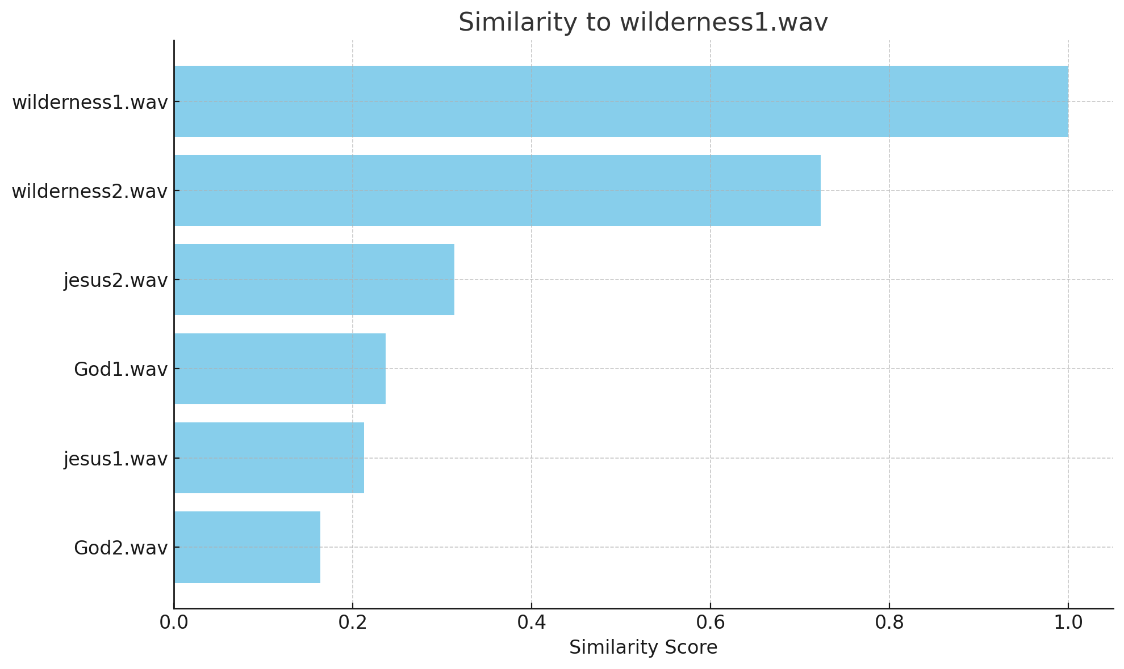
Report: Training/Testing
Similar to wilderness1.wav:
wilderness1.wav: 1
wilderness2.wav: 0.7229432647124682
jesus2.wav: 0.3134769071964211
God1.wav: 0.23680512842732715
jesus1.wav: 0.21231795463558845
God2.wav: 0.1635381466180469

Slide 16
Application: Keyword Checking
Check a text
Tagged Data
God
“In the beginning, God..”
Beginning
God
Beginning
Jesus
Wilderness
“In the beginning, was the Word..”
Word
Beginning
Word

Slide 17
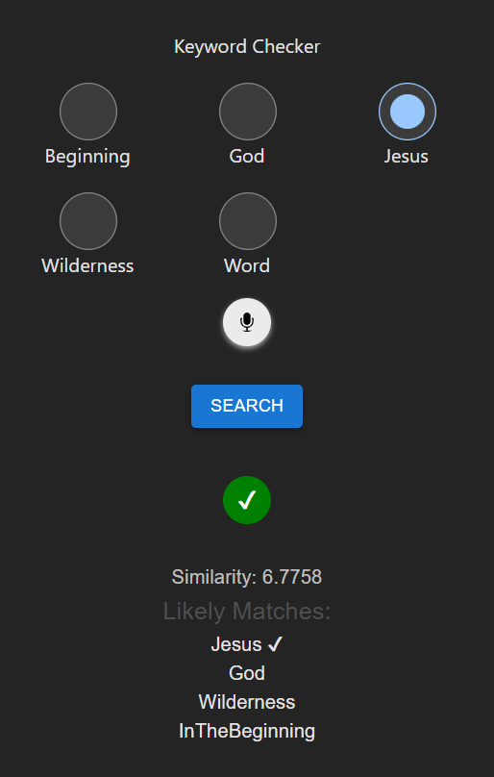
Demo

Slide 18
(Practical) Limitations
- Requires Internet access
- Also requires transmitting entire audio file
- ⁉ Possible to port to JS ? → Transmit “Fingerprint”
- File format impedance:
Web audio uses webm/ogg, but analysis libraries use wav/mp3
🔊
Dimensionality Reduction
Find Matches
Samples

Slide 19
(Analytical) Limitations
- Supervised method:
- Requires tagged data
- Inputs “from the field” – Signal noise:
- negatively affects precision → false positives
- negatively affects recall → problem identifying matches
- Solution:
- Improve the quality of inputs
- OR – more data

Slide 21
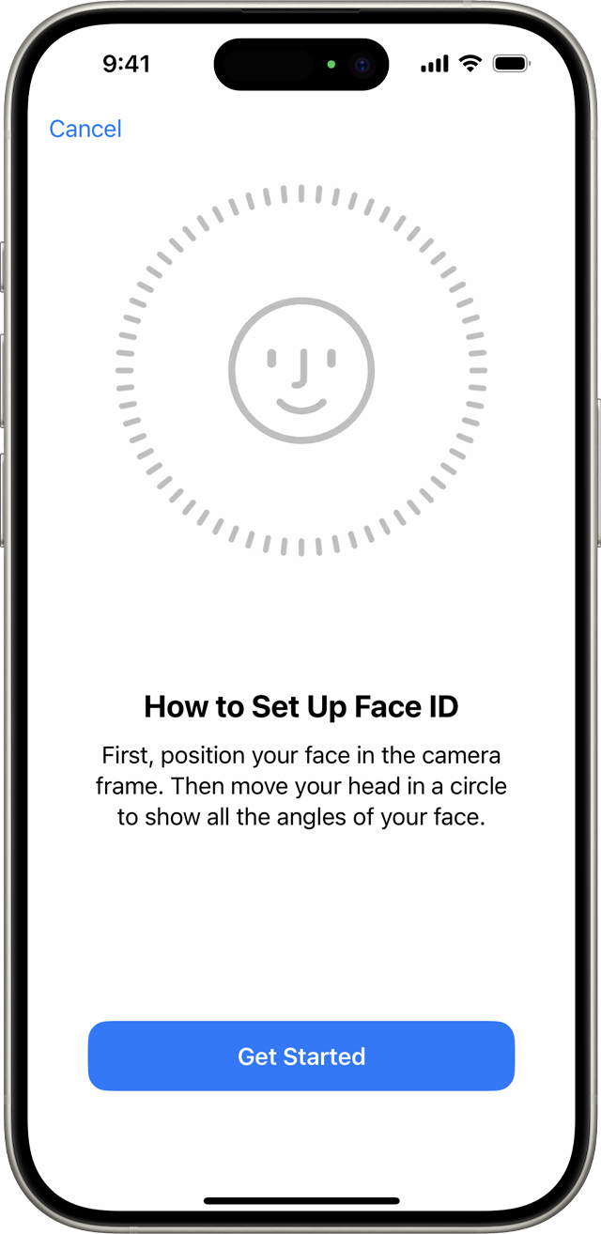
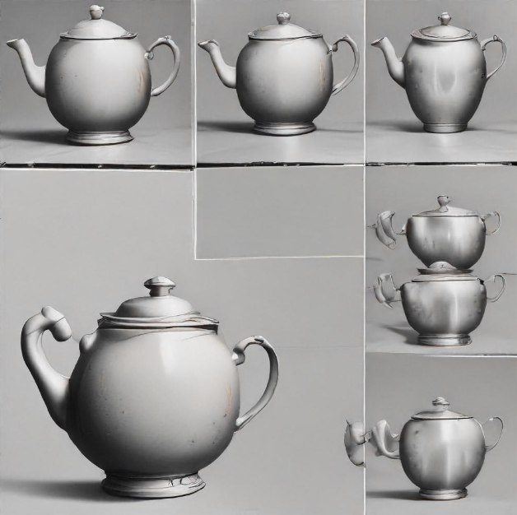

Slide 22
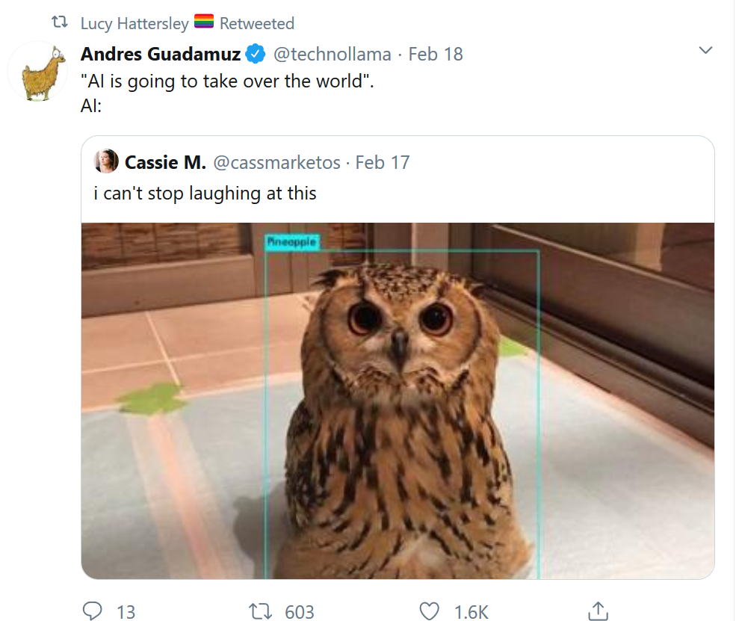

Slide 23
Application: Keyword Checking
Check a text
Tagged Data
God
“In the beginning, God..”
Beginning
God
Beginning
Jesus
Wilderness
“In the beginning, was the Word..”
Word
Beginning
Word

Slide 24
Text #N
Samples
Text #2
…
Text #1
Samples
Samples

Slide 25
Further Steps
- Testing / evaluation
- Precision (Low false-positives)
- Recall / Sensitivity (Correctly identified true matches)

Slide 26
THANK YOU!
I waited patiently for the Lord;
he turned to me and heard my cry.
...
Sacrifice and offering you did not desire—
but my ears you have opened—
burnt offerings and sin offerings you did not require.

